Slide 1


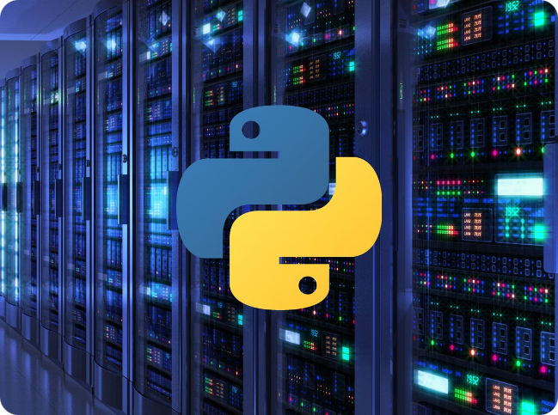


Introduction to Python
Python is a versatile, high-level programming language that is widely used for a variety of applications, from web development to data analysis and machine learning. With its easy-to-read syntax and powerful built-in libraries, Python is a great choice for beginners and experienced programmers alike.
by sushant sahu

Slide 2
Python Syntax and Basic Data Types
Syntax
Data Types
Variables
Python has a clean and expressive syntax that emphasizes readability. It uses indentation to define code blocks, making it easy to write and understand.
Python supports a variety of built-in data types, including integers, floats, strings, lists, tuples, and dictionaries, allowing you to work with different types of data.
Variables in Python are dynamically typed, meaning you don't need to declare the data type. You can simply assign a value to a variable and it will take on the appropriate type.

Slide 3

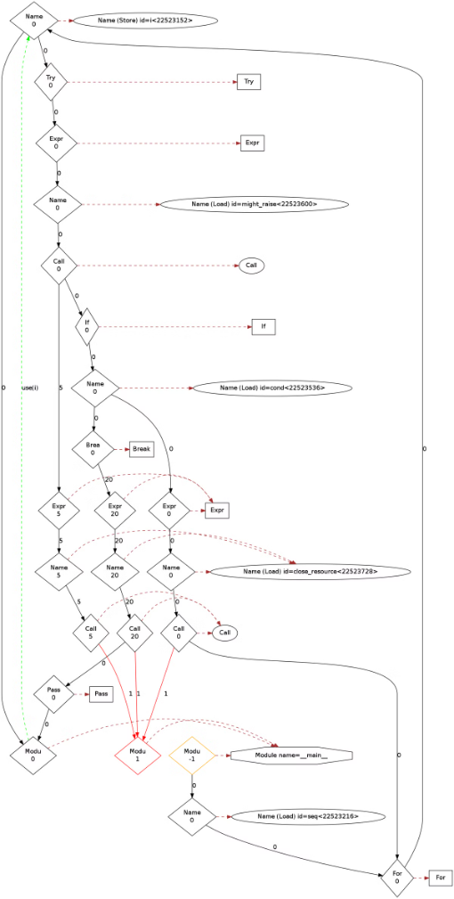
Control Structures and Conditional Statements
1
If-Else Statements
2
Loops
Python's if-else statements allow you to make decisions based on conditions, enabling you to write more complex and dynamic programs.
Python offers several loop structures, such as for and while loops, which allow you to repeatedly execute a block of code.
3
Boolean Logic
Python's Boolean operators (and, or, not) allow you to combine and negate conditions, providing more flexibility in your control structures.

Slide 4

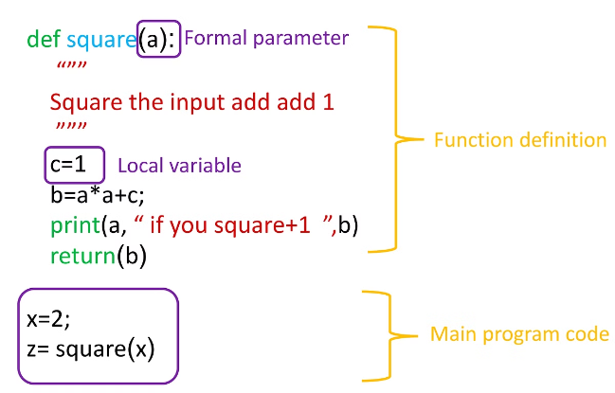
Functions and Modules
1
Functions
Functions in Python allow you to encapsulate reusable logic, making your code more modular and easier to maintain.
2
Arguments and Return Values
Functions can take arguments and return values, enabling you to pass data into and out of your functions.
3
Modules
Python's module system allows you to organize your code into logical units, making it easier to manage and share your code with others.

Slide 5

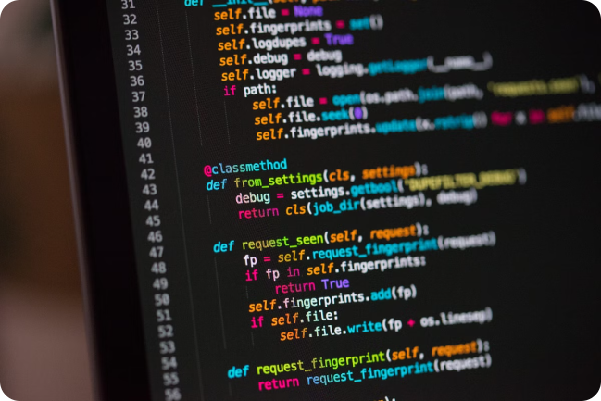
Object-Oriented Programming in Python
Classes
Inheritance
Python supports object-oriented programming, allowing you to create custom classes and objects to model real-world entities and concepts.
Python's inheritance feature enables you to create hierarchical relationships between classes, promoting code reuse and modularity.
Encapsulation
Python provides mechanisms for data encapsulation, such as public, private, and protected access modifiers, to control the visibility and accessibility of class members.

Slide 6


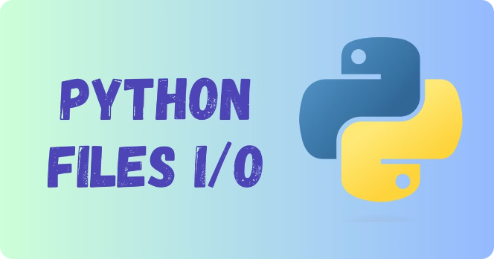


File I/O and Exception Handling
File I/O
Python offers powerful file handling capabilities, allowing you to read, write, and manipulate data stored in various file formats.
Exception Handling
Python's exception handling system enables you to anticipate and gracefully handle errors that may occur during program execution.
Logs and Debugging
Python provides tools and libraries for logging and debugging, which are essential for developing, testing, and maintaining robust applications.

Slide 7
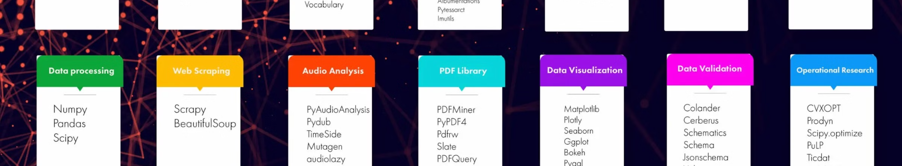



Python Libraries and Frameworks
NumPy and SciPy
Django and Flask
TensorFlow and PyTorch
These libraries provide powerful tools for scientific computing, including numerical operations, linear algebra, and data analysis.
These web development frameworks simplify the process of building robust and scalable web applications in Python.
These machine learning libraries enable you to build and deploy sophisticated artificial intelligence and deep learning models.

Slide 8

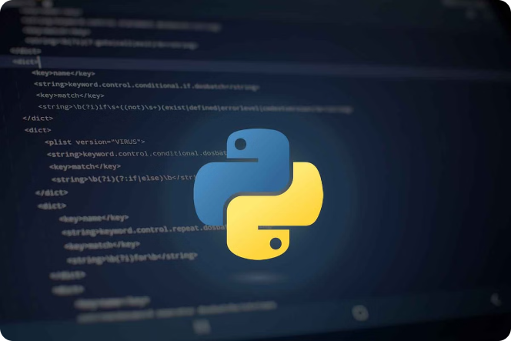
Conclusion and Next Steps
Conclusion
Python is a versatile and powerful programming language that is widely used in various industries. Its simplicity, readability, and extensive ecosystem of libraries and frameworks make it an excellent choice for both beginners and experienced developers.
Next Steps
To continue your Python journey, consider exploring specific domains such as web development, data analysis, machine learning, or automation. Participate in online communities, contribute to open-source projects, and continuously learn and practice to become a proficient Python programmer.

